Slide 1
Sand fences Pentwater Village Council
May 11, 2015

Slide 2
Channel shoaling
Probably two causes
Alongshore currents forming sandbar at channel entrance
Blowing sand from beaches

Slide 3
Evidence for blowing sand
Substantial sand against winter snow fences and trial barriers
Substantial sand on pier walks
Apparent improvement with trial barriers

Slide 4
Proposed solution
Engineering study by Fleis and Vandenbrink
Funded privately
Much credit to Tom Sturr and Manny Valdez

Slide 5
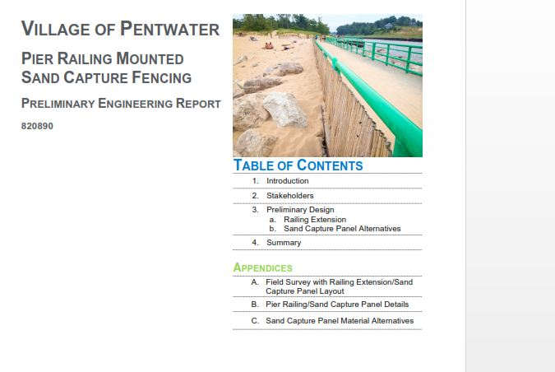

Slide 6
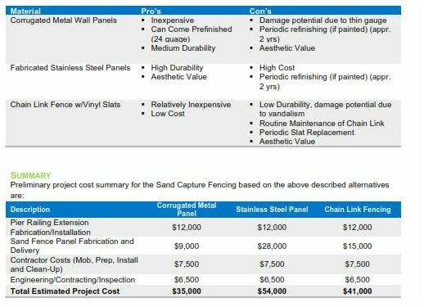

Slide 7
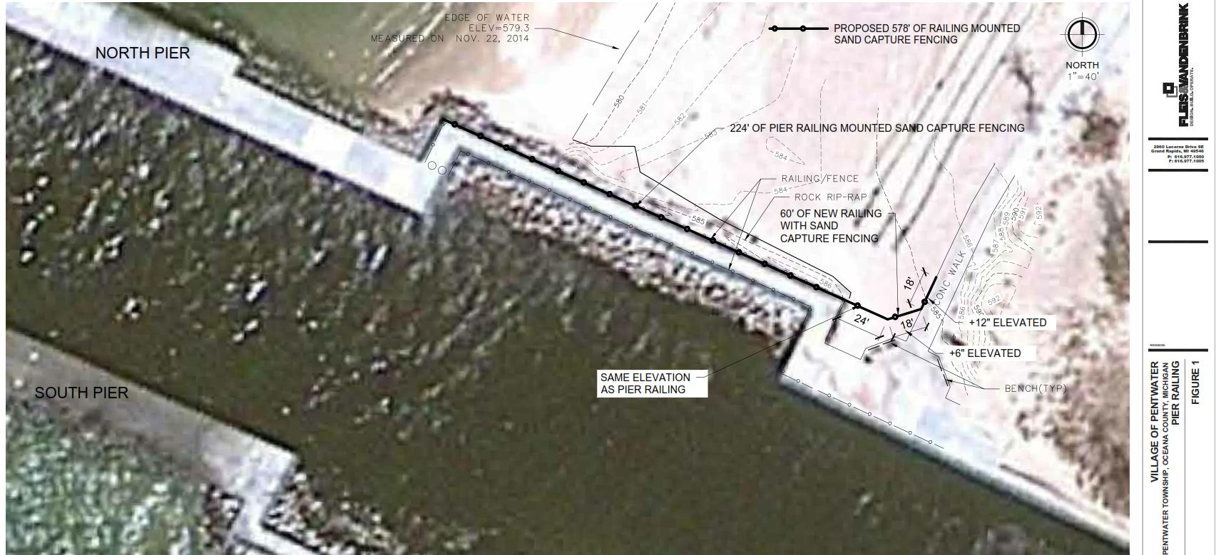

Slide 8
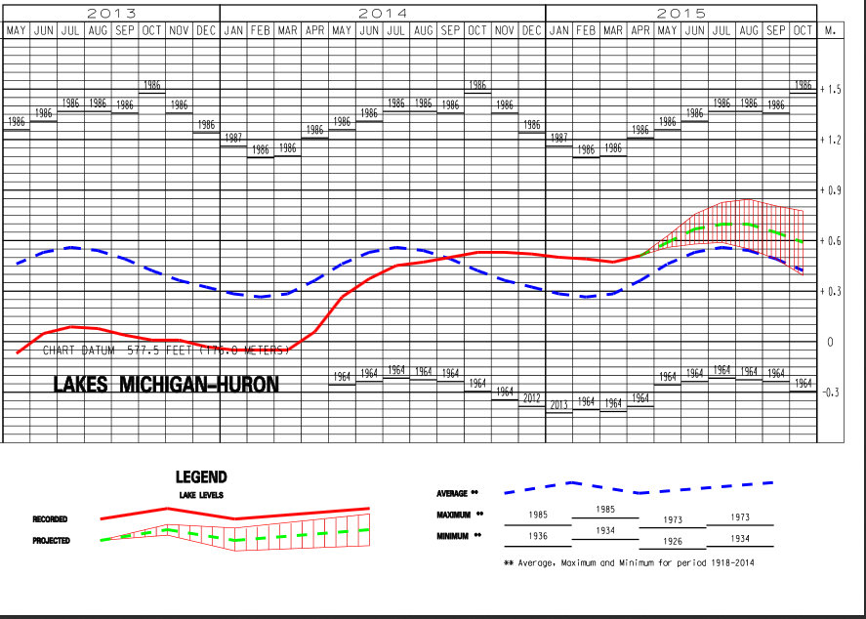

Slide 9
Thoughts
We will probably escape need to dredge again this year because of higher Lake Michigan levels
It is likely that Lake levels will drop again, arguably beyond historic values
Must prepare for local funds to maintain channel navigability
Annual budget
Widest possible participation
Village
Township
Lake Improvement Board

Slide 10
Possible downsides
Wrong diagnosis
Visual
Difficulty maintaining railing

Slide 11
Recommendation
Fund permanent fencing and arrange for periodic sand removal

Slide 12
Plans
Continue mapping
Side-scan sonar imaging
Possible high-quality scanning by Great Lakes Water Studies Institute of Northwestern Michigan College
Continued collaboration with Great Lakes Research Center
Profile current

